Slide 1
Speaker interpolation for HMM-based speech synthesis system
Source: J. Acoust. Soc. Jap. (E), vol.21
Author : Takayoshi Yoshimura, Keiichi Tokuda
Professor : 陳嘉平
Reporter : 楊治鏞

Slide 2
Introduction
This paper proposes a speaker interpolation technique for the HMM-based speech synthesis system to synthesize speech with untrained speaker's characteristics by interpolating HMM parameters among some representative speakers' HMM sets.

Slide 3
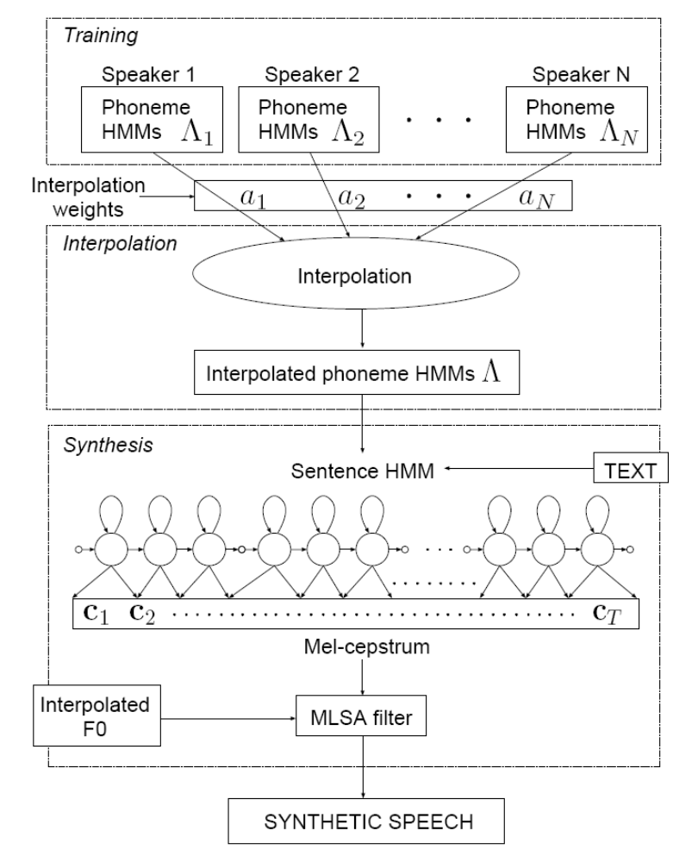

Slide 4
Speaker Interpolation
Fig. 2 shows a space of speaker individuality.
We assume that representative speaker’s HMMs have the same topology (distributions could be tied).
Under this assumption, interpolation among HMMs is equivalent to interpolation among output probability densities of corresponding states when state-transition probabilities are ignored.

Slide 5




Speaker Interpolation
If we assume that each HMM state has a single Gaussian output probability density, the problem is reduced to interpolation among N Gaussian pdfs, , k= 1, 2, . . . , N, where and denote mean vector and covariance matrix, respectively, and is the speech parameter vector.

Slide 6
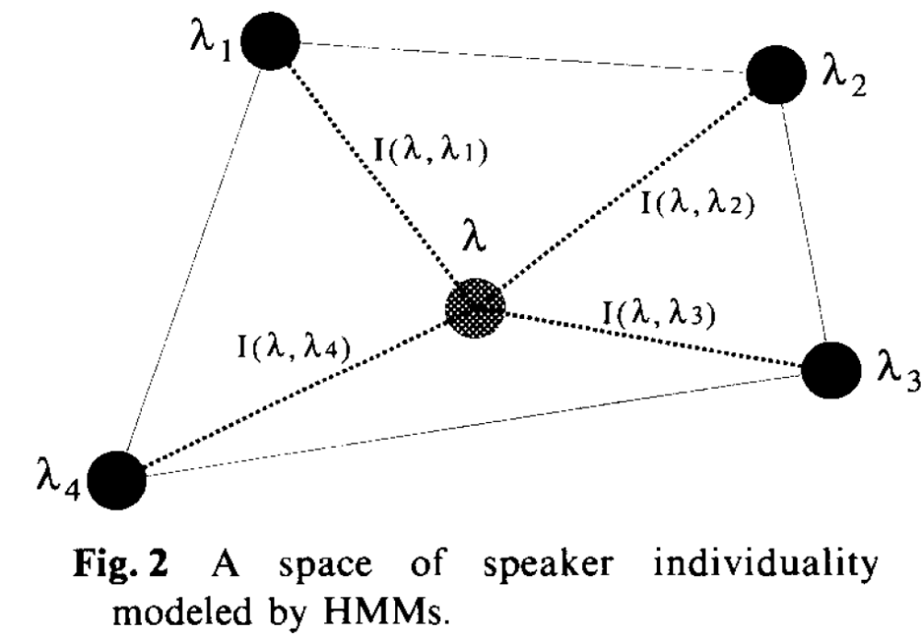

Slide 7

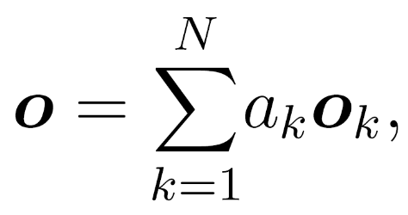



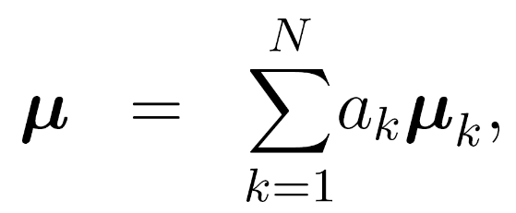
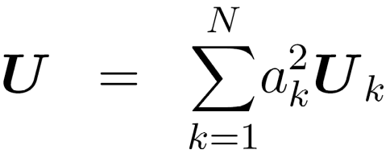
Method (a)
When we define the interpolated pdf as pdf of random variable
Where , the mean and variance is calculated as follows:

Slide 8





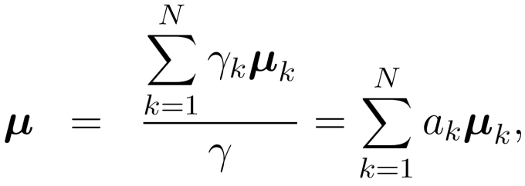
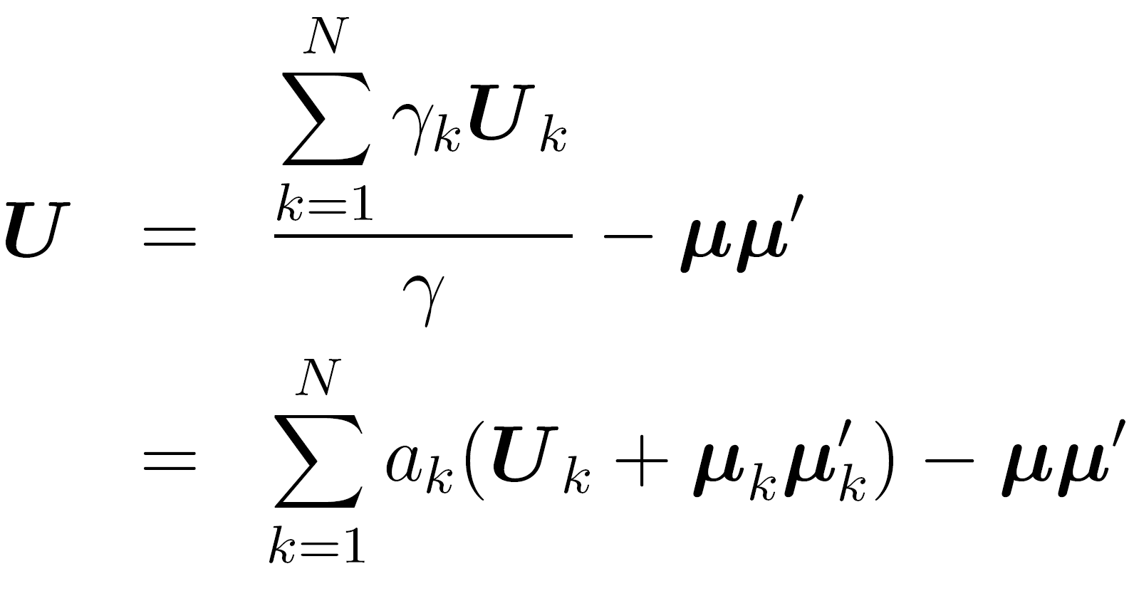
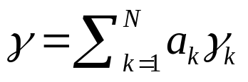

Method (b)
We assume that mean and covariance are trained by using feature vectors of speaker .
If the interpolated pdf is trained by using feature vectors of representative speakers, this pdf is determined as
respectively, where and .

Slide 9





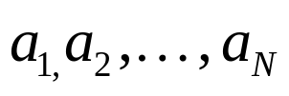
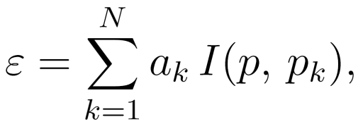
Method (c)
We assume that the similarity between the interpolated speaker and each representative speaker can be measured by Kullback information measure between
and .
Then, for given pdfs and weights , consider a problem to obtain pdf which minimizes a cost function

Slide 10


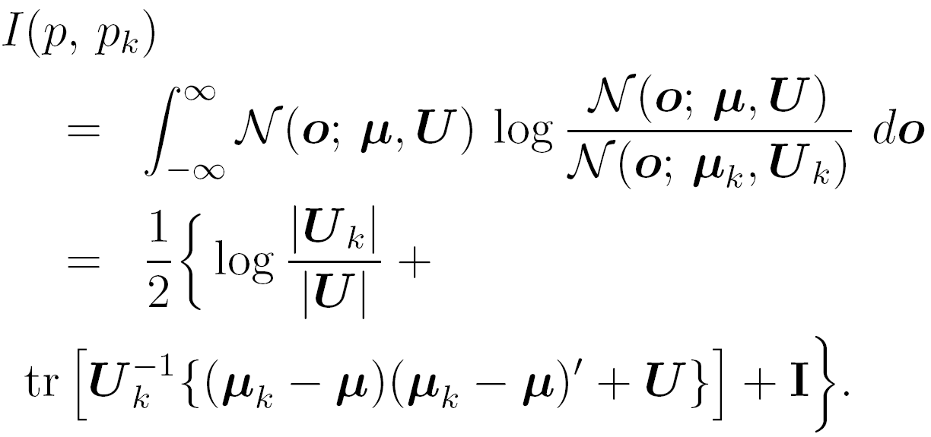
Method (c)
We can determine the interpolated pdf by minimizing with respect to and , where the Kullback information measure can be written as

Slide 11
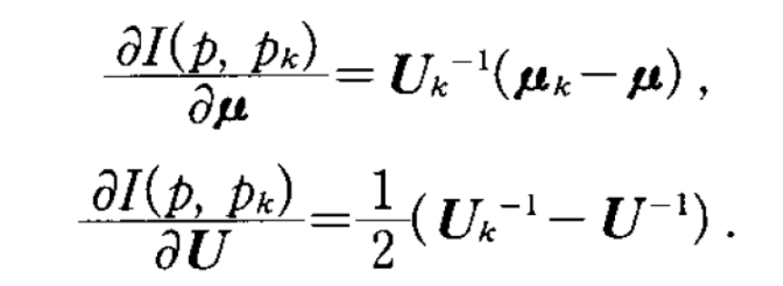
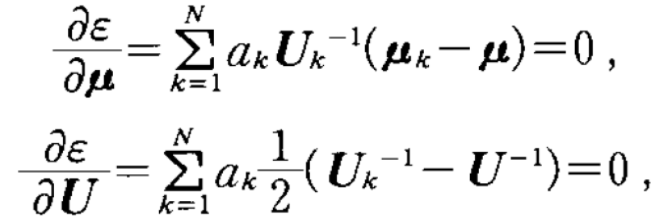
Method (c)
By differentiating
Minimize

Slide 12

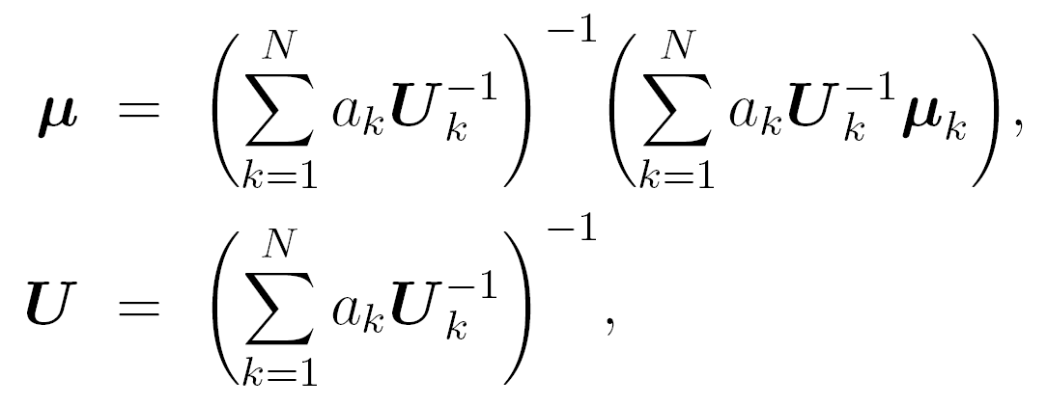
Method (c)
As a result, and are determined by

Slide 13


Simulation
From the figure, it can be seen that in methods (a) and (b) the interpolated mean vector is determined irrespective of covariances of representative distributions
and .
On the other hand, the method (c) can interpolate between two distributions appropriately in the sense that the interpolated distribution p reflects the statistical information, i.e., covariances of and .

Slide 14
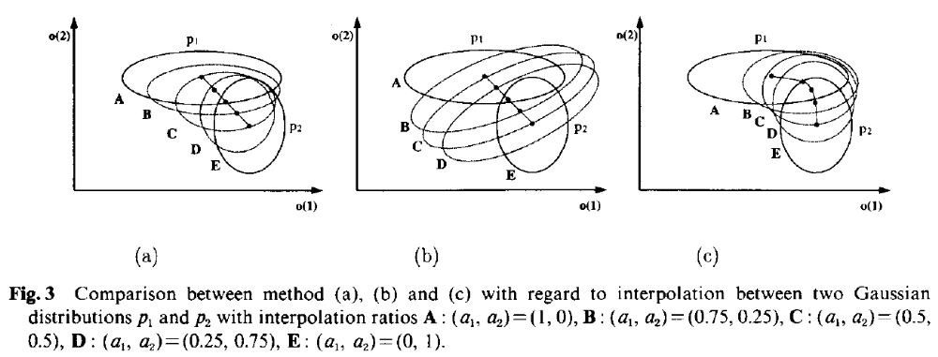
Simulation

Slide 15
Simulation
Fig. 3 shows spectra which correspond to mean vectors of interpolated Gaussian distributions.
It can be seen that the formant structure of spectra interpolated by the method (a) and (b) are collapsed.
On the other hand, the spectra interpolated by the method (c) keep the formant structure.

Slide 16
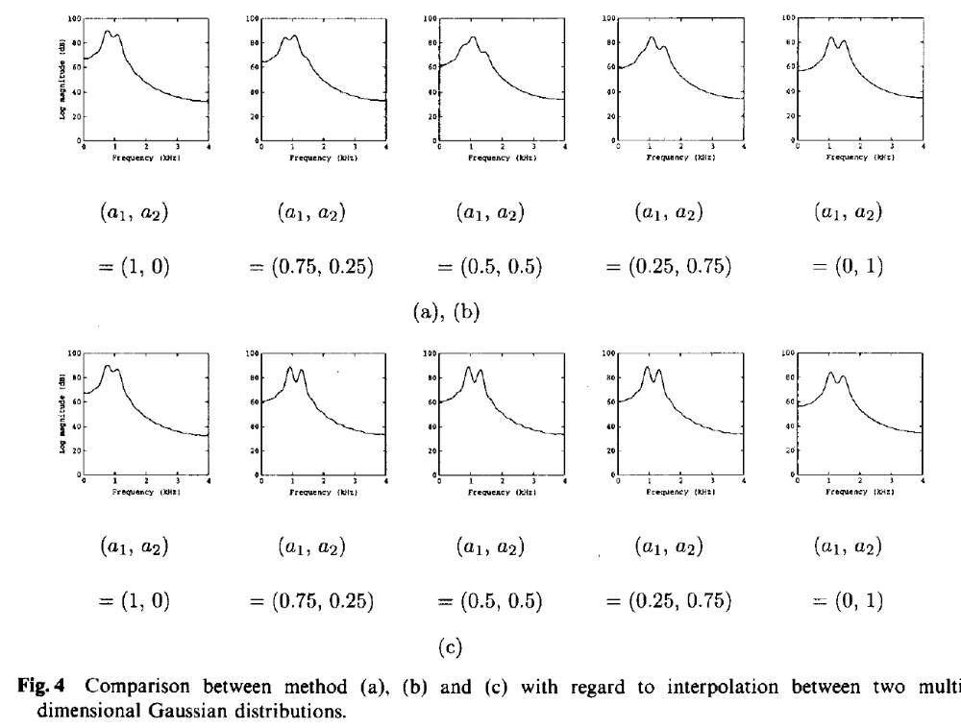
S

Slide 17

Experiment
We used phonetically balanced 503 sentences from ATR Japanese speech database for training.
We trained 2 HMM sets using 503 sentences uttered by a male speaker MHT and 503 sentences uttered by a female speaker FKN.
We set interpolation ratio as = (1; 0), (0:75; 0:25), (0:5; 0:5), (0:25; 0:75), (0; 1).

Slide 18
Generated Spectra
Fig.5 shows spectra of a Japanese sentence “/n-i-m-o-ts-u/” generated from the triphone HMM sets.
From the figure, it can be seen that spectra change smoothly from speaker MHT’s to speaker FKN’s according to the interpolation ratio.

Slide 19
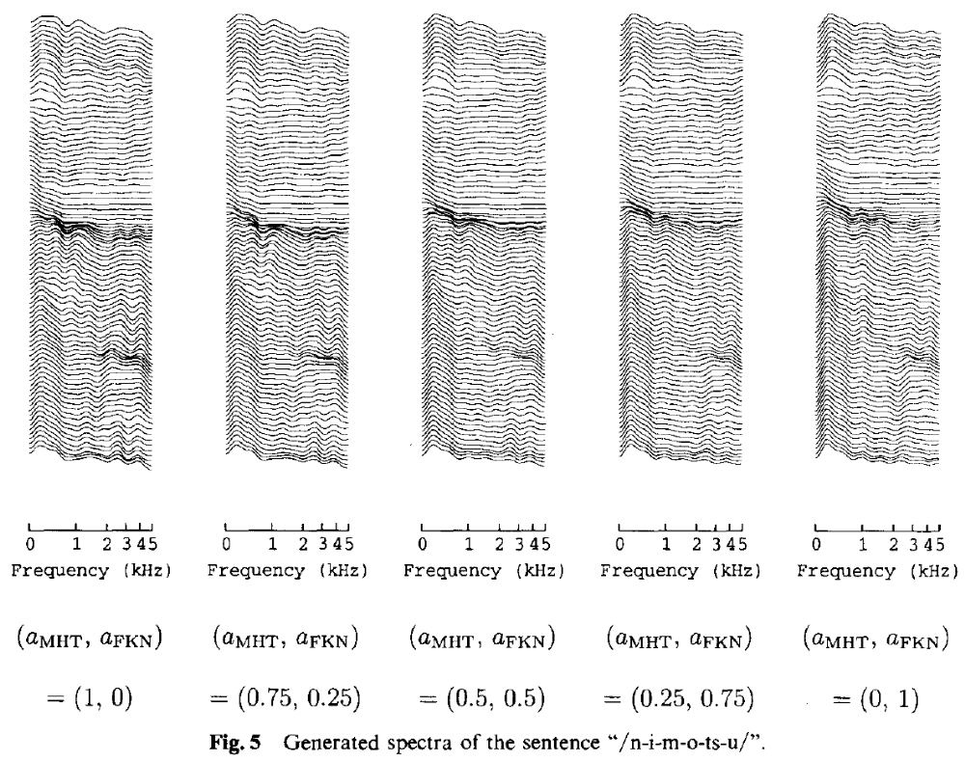

Slide 20
ABX Listening Tests
Stimuli A and B were either MHT's or FKN's synthesized speech.
Stimulus X was either 5 utterance synthesized with different interpolation ratio.
Subjects listened this 5 utterance at random and were asked to select either A or B as being the closest.

Slide 21
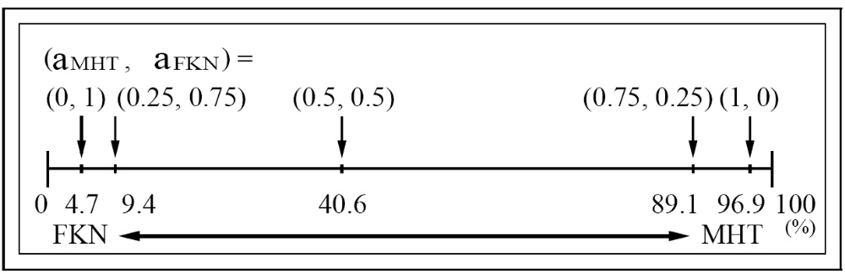
ABX Listening Tests

Slide 22
Experiments of Similarity
In these tests, 2 sentences, which were different from training data, were synthesized and tested.
Stimuli consisted of 2 samples in 5 utterance which were different interpolation ratio.
Subjects were asked to rate the similarity of each pair into five categories ranging from “similar” to “dissimilar”.

Slide 23
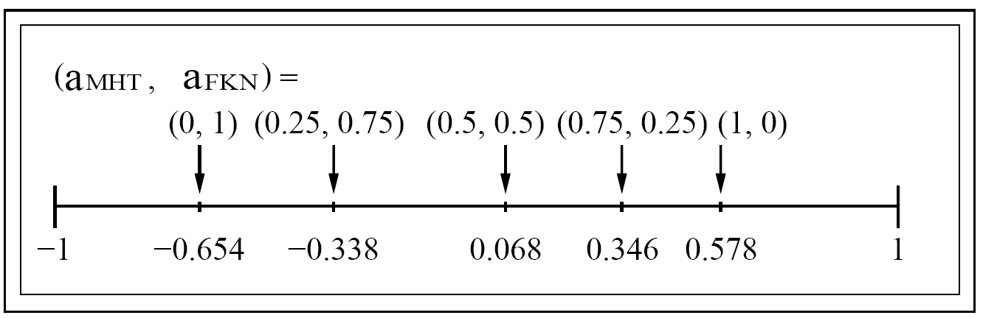
Experiments of Similarity

Slide 24
Conclusion
From the results of experiments, we have seen that the quality of synthesized speech from the interpolated HMM set change smoothly from one male speaker’s to the other female speaker’s according to the interpolation ratio.
We expect that the emotion (e.g., anger, sadness, joy) interpolation might be possible by replacing HMMs of representative speakers with those of representative emotions.

